Slide 1
Legislative Oversight State Medicaid Programs
Ben Eikey
Levin Center for Oversight and Democracy
State Oversight Academy
December 13th, 2023
levincenter@wayne.edu

Slide 2
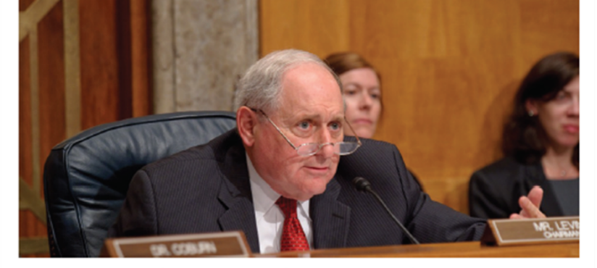
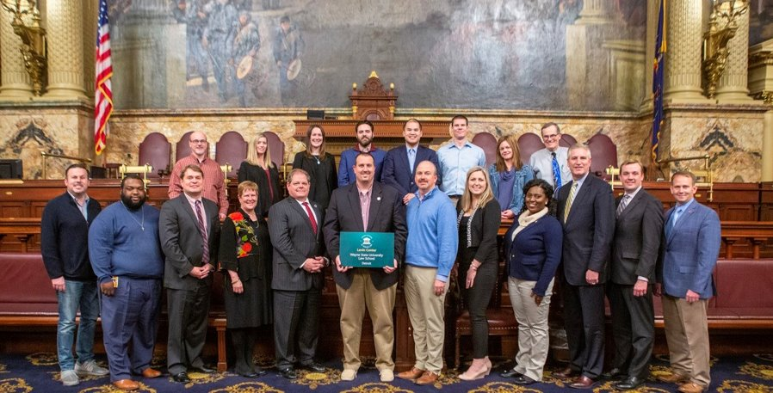
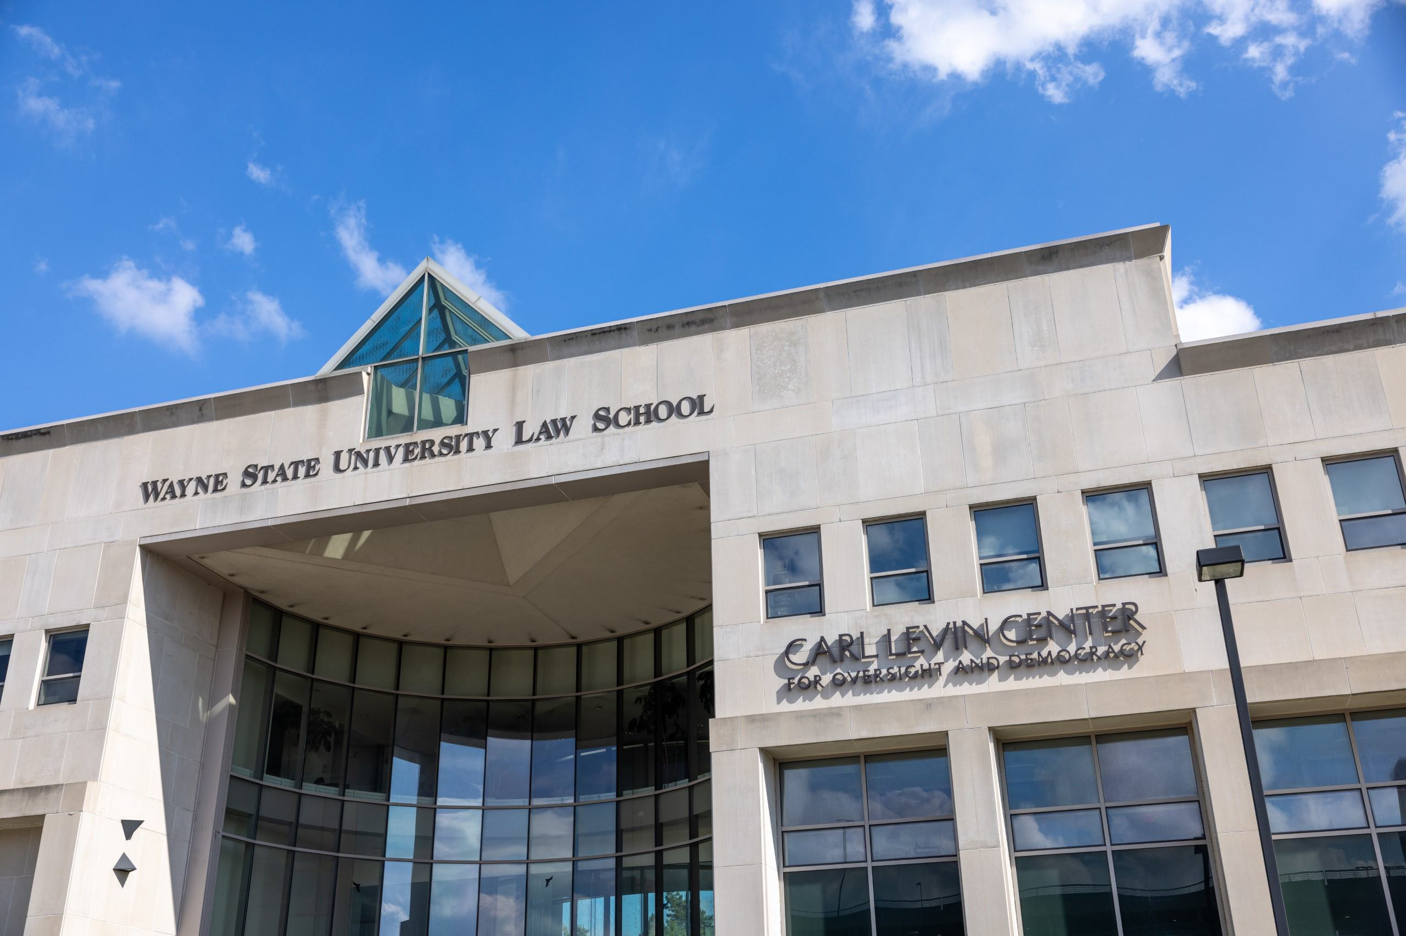
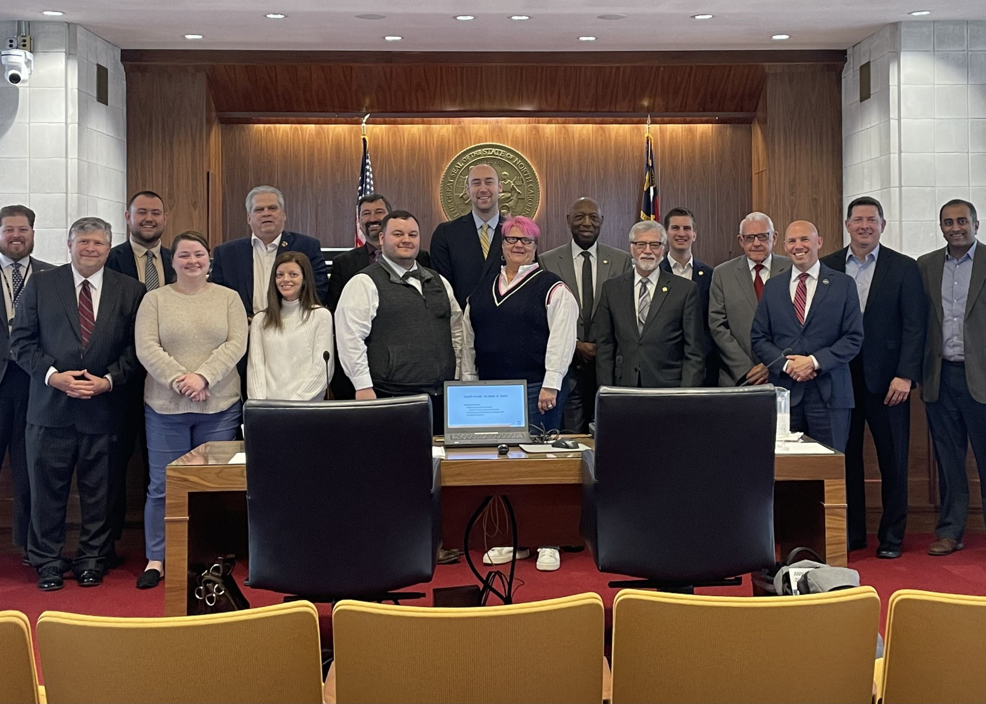
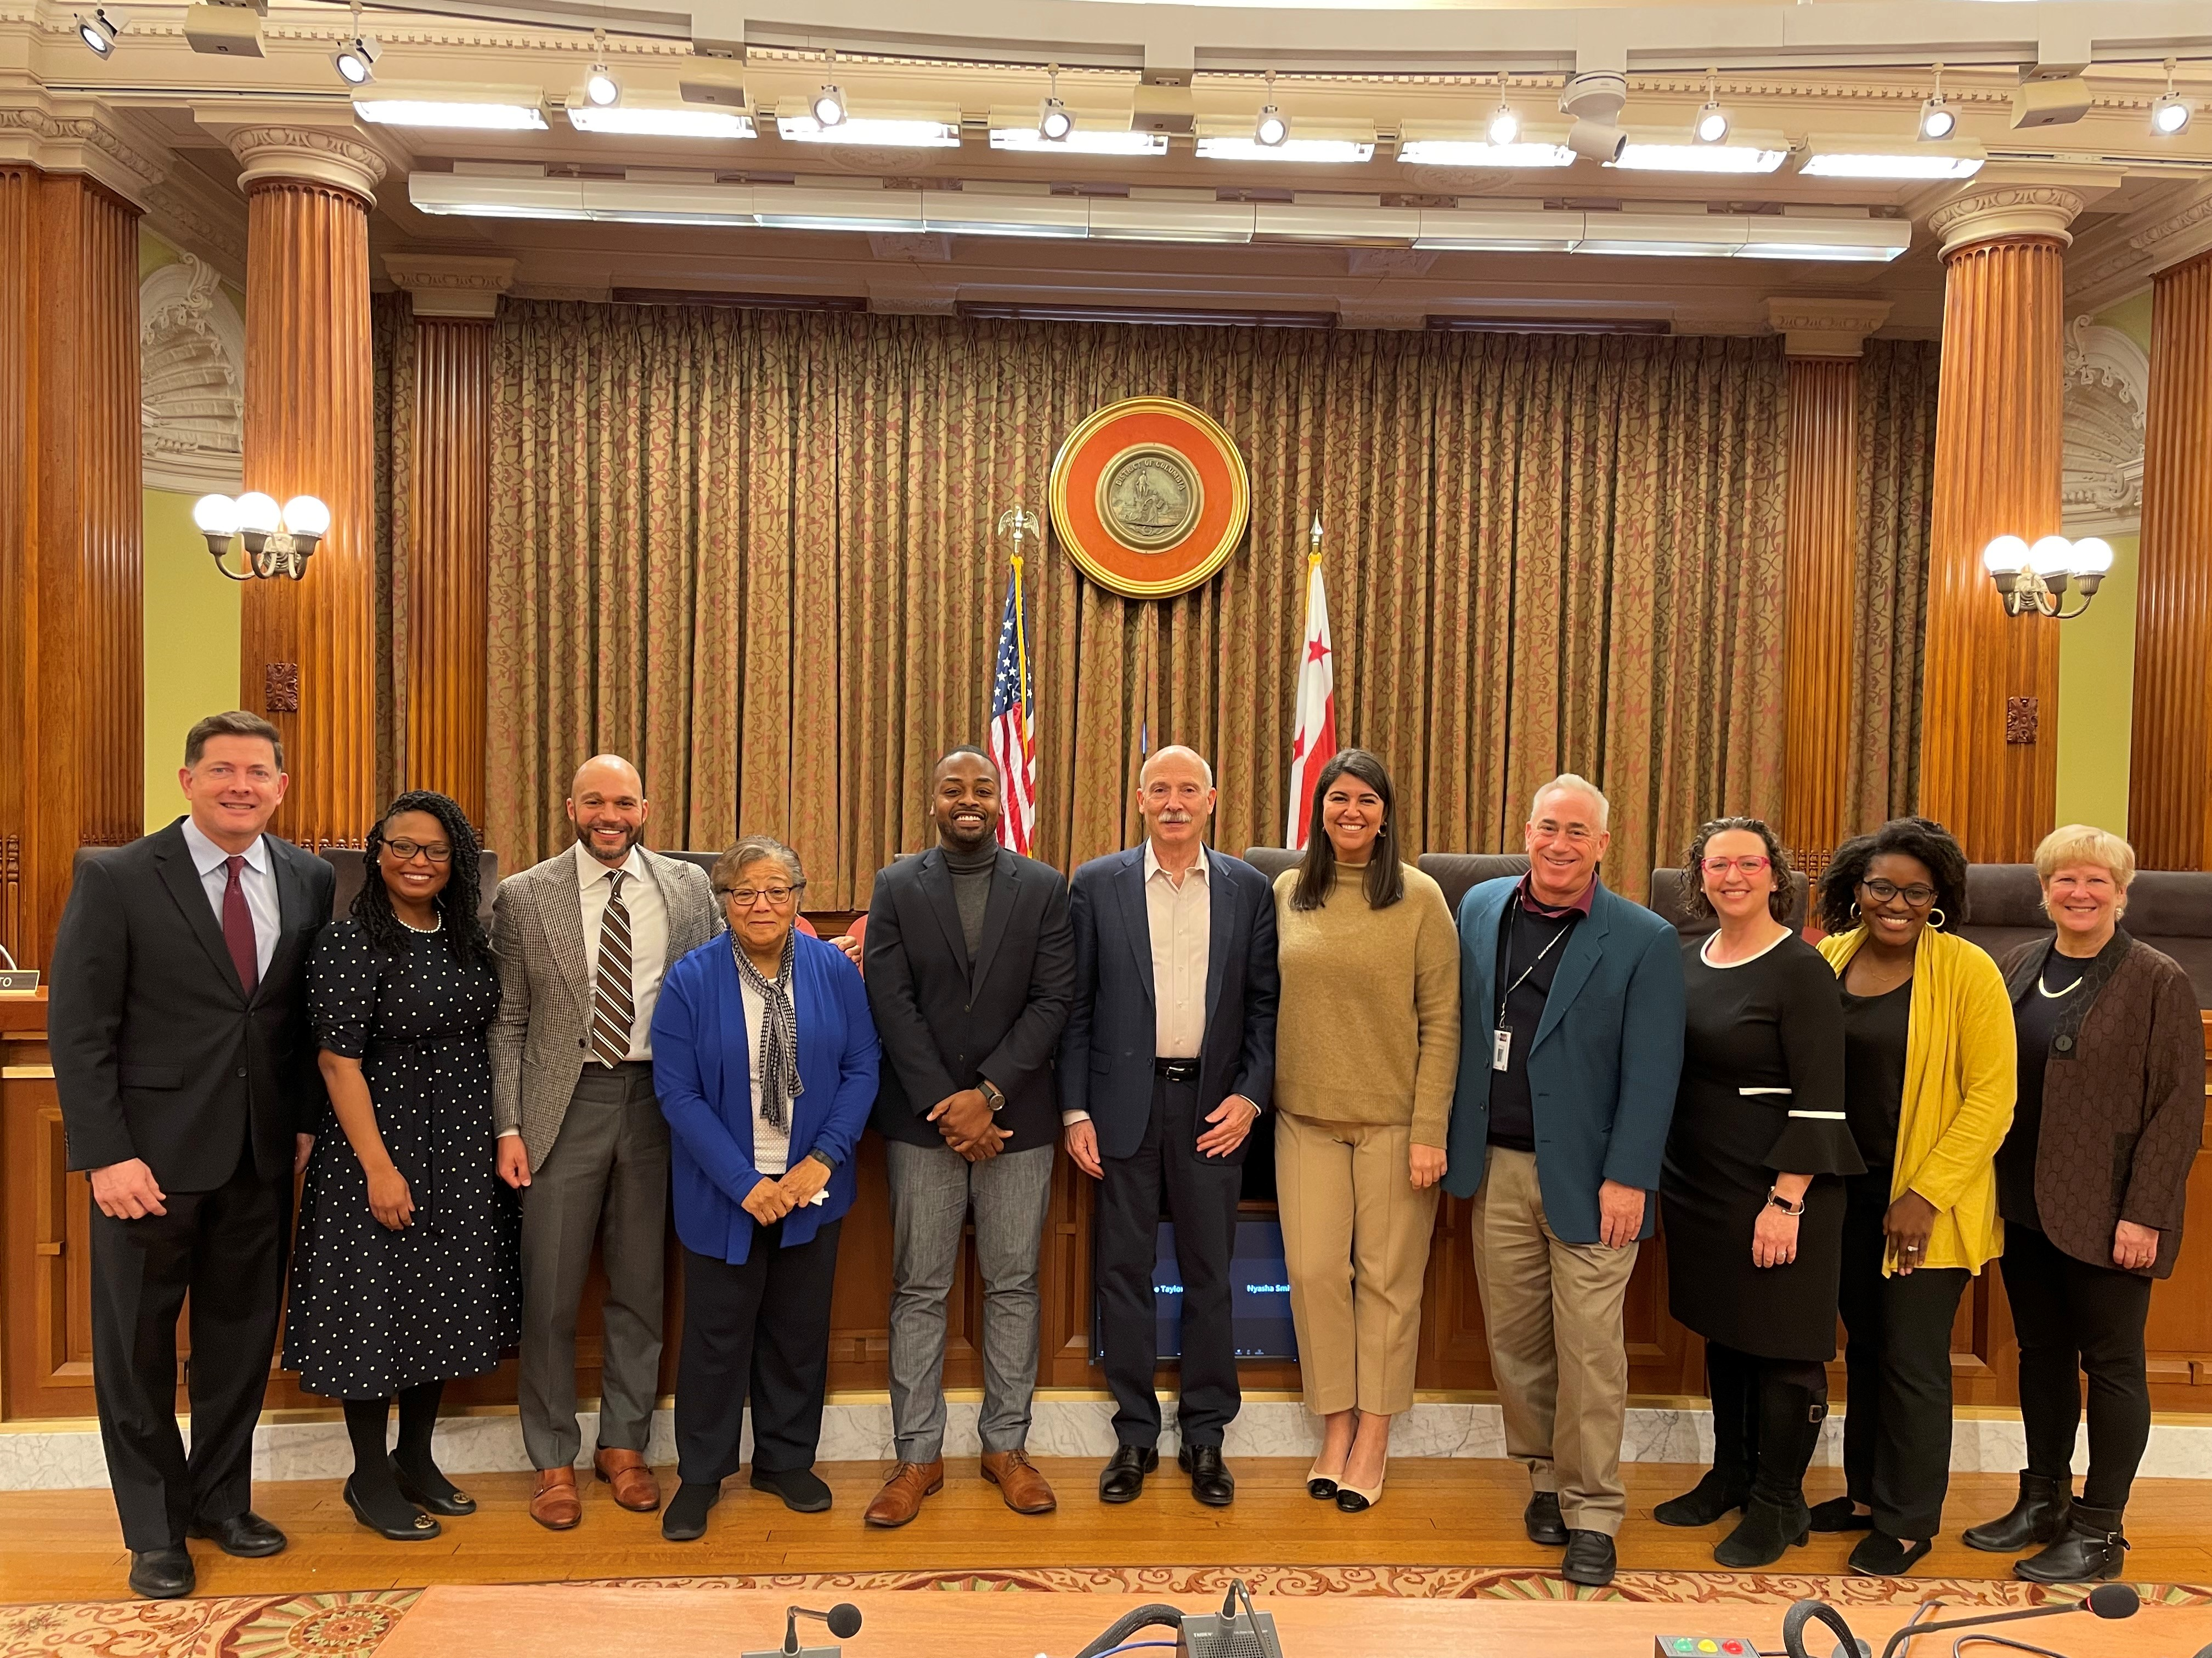
Levin Center for Oversight and Democracy​
U.S. Sen. Carl Levin
Pennsylvania Oversight Committee
Wayne State Law School
Workshops for Congress, state, international legislatures​
Videos, testimony, webinars, social media
Research & Reports (50-state analysis, contract oversight, more)​
Conferences, panels & events
State Oversight Academy
More: Benjamin.Eikey@wayne.edu
DC Council Oversight Workshop
North Carolina General Assembly
Oversight Workshop
levincenter@wayne.edu

Slide 3
Agenda
What is Legislative Oversight?
State Oversight Academy Wiki
Oversight Topics, Phases of an Investigation
Recommended Best Practices
Crafting a Medicaid Oversight Plan
Oversight Scenario
levincenter@wayne.edu

Slide 4
What is Legislative Oversight? The “eyes and voice” of the people
“It is the proper duty of a representative body to look diligently into every affair of government and to talk much about what it sees. It is meant to be the eyes and the voice, and to embody the wisdom and will of its constituents.”
-- United States Supreme Court¹
---------------------
¹ Trump v. Mazars USA, LLP, 140 S.Ct. 2019, 2031 (2020), citing United States v. Rumely, 345 U. S. 41, 43 (1953).
levincenter@wayne.edu

Slide 5
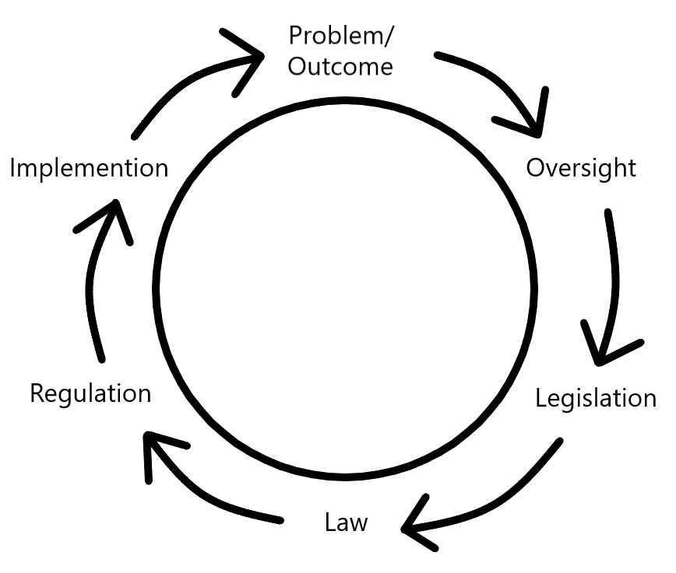
Cycle of Accountability
Eyes and Voice of
the People
levincenter@wayne.edu

Slide 6
Cycle of Accountability
Eyes and Voice of
the People
levincenter@wayne.edu

Slide 7
Routine or Event-Driven Oversight?
Routine: "cop on the beat" | Event-Driven: "firefighter"
Program Outcomes | Scandal
Budgetary | Disaster
Contracts | Chronic Problems
Compliance | Escalating Problems
Deter Malfeasance | Long-term Investigation
levincenter@wayne.edu

Slide 8
Your Superpowers
Legislator phone calls and emails get returned.
Legislators can request investigations and reports.
Legislator questions trigger research, reconsideration, change.
Oversight can have as much, or more, impact as legislation.
levincenter@wayne.edu

Slide 9
Avenues for State Legislative Oversight
Analytic Bureaucracies
Appropriations Process
Committees
Administrative Rule Review
Advice and Consent
Monitoring Contracts
levincenter@wayne.edu

Slide 10
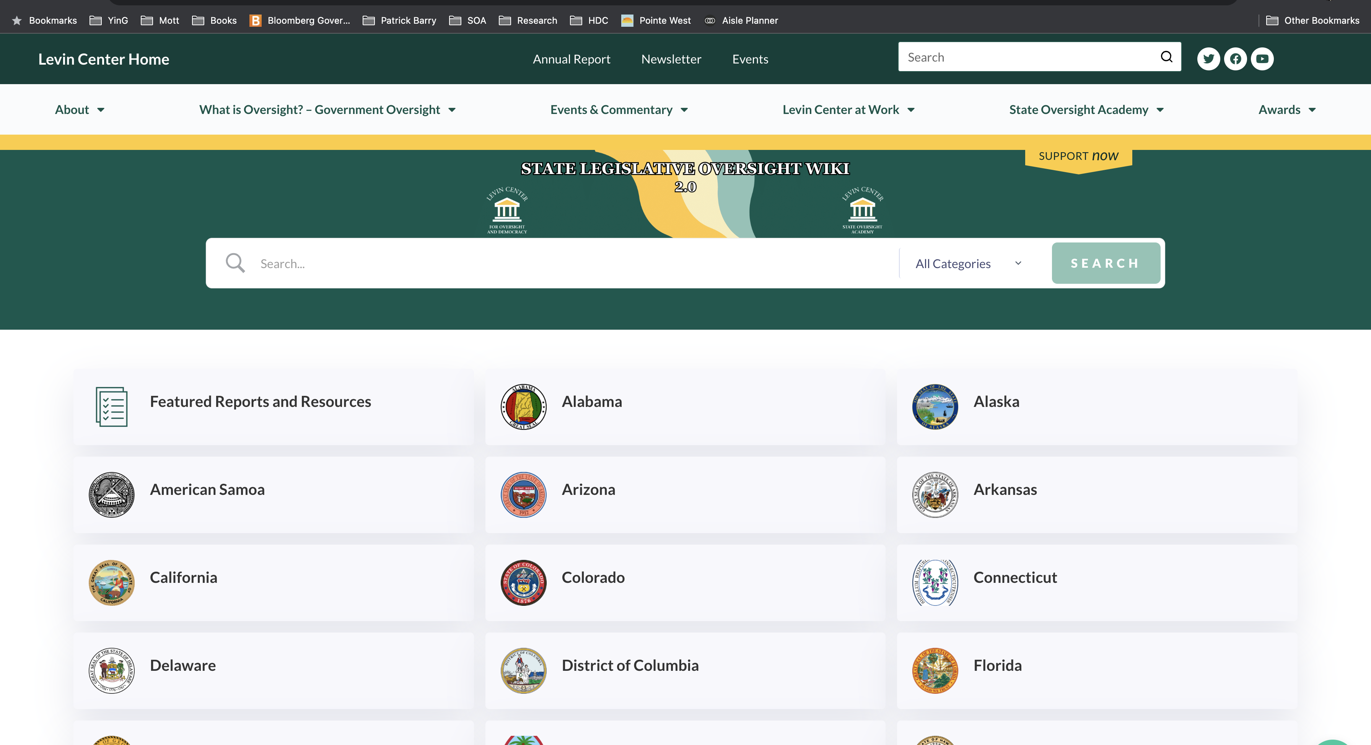
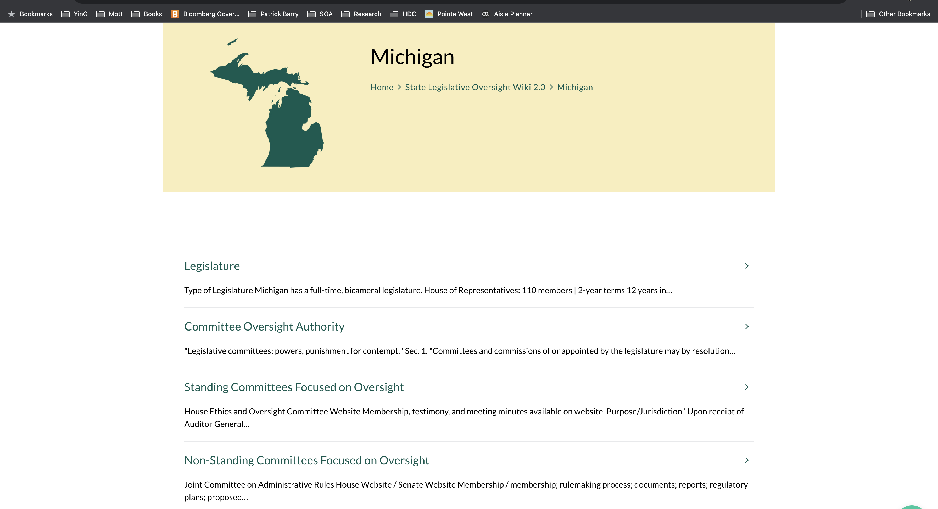
State Oversight Academy State Legislature Oversight Wiki

Slide 11
Origin of Investigation Topics
Committee jurisdiction
Leadership concerns
Scandals, events, news, problems
Reports
Constituents
Whistleblowers, advocacy groups
Legislator concerns
Lawsuits
Agencies
Personal experience
Oversight plan, long-term vision
levincenter@wayne.edu

Slide 12
Examples of Topics
Pension funds
Prison Operations
Foster care
Disaster response and mitigation
Lobbying disclosures
Contract mismanagement
Infrastructure
levincenter@wayne.edu

Slide 13
Phases of an Investigation
Fact-Finding
Written Product
Hearing
Follow up
Tutorials: https://levin-center.org/congressional-lawmakers/online-tutorials/
levincenter@wayne.edu

Slide 14
South Carolina
House Oversight Committee
Full Committee plus five subcommittees
Video archive and minutes of all meetings
Public input form, plus info on testimony submission
Restructuring recommendations for agencies
Seven-year agency reviews
levincenter@wayne.edu

Slide 15
South Carolina
House Oversight Committee
Transparency report to citizens
Purpose, findings, and recommendations
All reports available online since 2014
Oversight Matters Podcast: Rep. Wes Newton: https://levin-center.org/what-is-oversight/oversight-matters/
levincenter@wayne.edu

Slide 16
Recommendations for Strengthening Oversight
Joint oversight committee with balanced party membership E.g., Michigan SJR O, 2022
Bipartisan approach to topics, inquiry, witnesses, questions, etc.
More follow-up (e.g., hearings) on reports.
More contract oversight.
Create oversight plan for a committee, or even full legislature.
Post status and results of investigations on website.
For additional resources: https://www.levin-center.org/state-lawmakers/state-oversight-resources/
levincenter@wayne.edu

Slide 17
Oversight Planning
Oversight planning can and should be undertaken at any of these levels:
Entire legislature
House/Senate
Caucus
Committee
Investigation
For additional resources: https://levin-center.org/state-oversight-academy/state-oversight-resources/
levincenter@wayne.edu

Slide 18
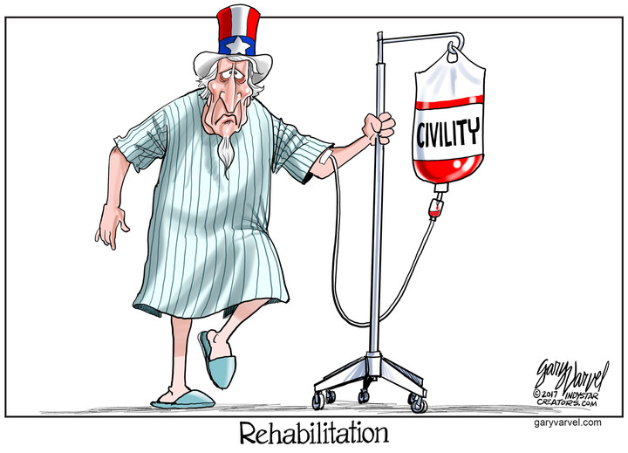
Civility in Oversight
When conducting an inquiry,
Focus on process over personalities.
Poor results are not always the agency personnel's fault.
Remember that building effective partnerships with agency personnel is often a better path to meaningful change than misusing oversight as a disciplinary tool.
Build a positive culture by expecting agency personnel and members from the other party are also pursuing information and problem solving in good faith.
Let the facts be the guide.
For additional resources: https://levin-center.org/state-oversight-academy/state-oversight-resources/
levincenter@wayne.edu

Slide 19
Medicaid Oversight Plan
Topic | Subtopic | Factual Question | Avenue(s) | Routine/Event Driven (Required Resources) | Timeline
Health Equity and Justice | Medicaid and Reentry | How do returning citizens that qualify for Medicaid become covered?
Avenues:
Analytic Bureaucracies
Appropriations Process
Committees
Admin Rule Review
Advice and Consent
Monitoring Contracts
levincenter@wayne.edu

Slide 20
Medicaid Oversight Scenarios
Topic | Subtopic | Factual Question | Avenue(s) | Routine/ Event Driven (Required Resources) | Timeline
Analytic Bureaucracies
Appropriations Process
Committees
Admin Rule Review
Advice and Consent
Monitoring Contracts
Children
Expansion
Health Equity and Justice
Disability Access
Safety Net Providers
Trauma Informed Care
Opioid Use Disorder
Primary Care Deserts
Long Term Servicing and Medicaid Funding
Medicaid Unwinding
Medicaid Home and Community-Based Waivers
levincenter@wayne.edu

Slide 21
Q&A
levincenter@wayne.edu

Slide 22
Thank you!
For more information, contact:
Ben Eikey, Benjamin.Eikey@wayne.edu
State Oversight Resources: https://www.levin-center.org/state-lawmakers/state-oversight-resources/
State Oversight Workshops: https://www.levin-center.org/state-lawmakers/oversight-workshops/
levincenter@wayne.edu

