Slide 1
Enhancing Reforms in Public Safety
Ben Eikey
Levin Center for Oversight and Democracy
State Oversight Academy
levincenter@wayne.edu

Slide 2
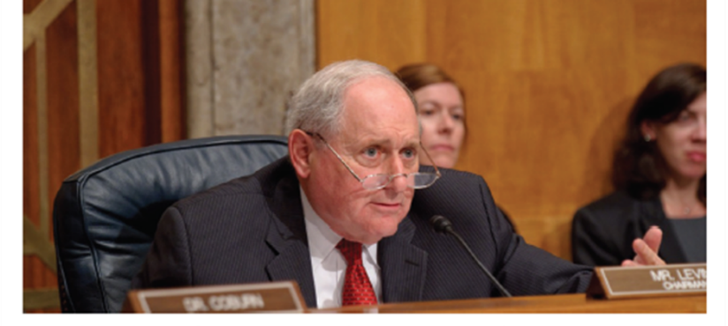
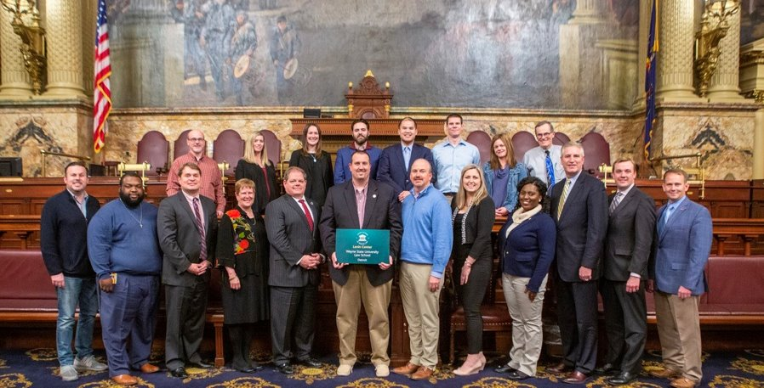
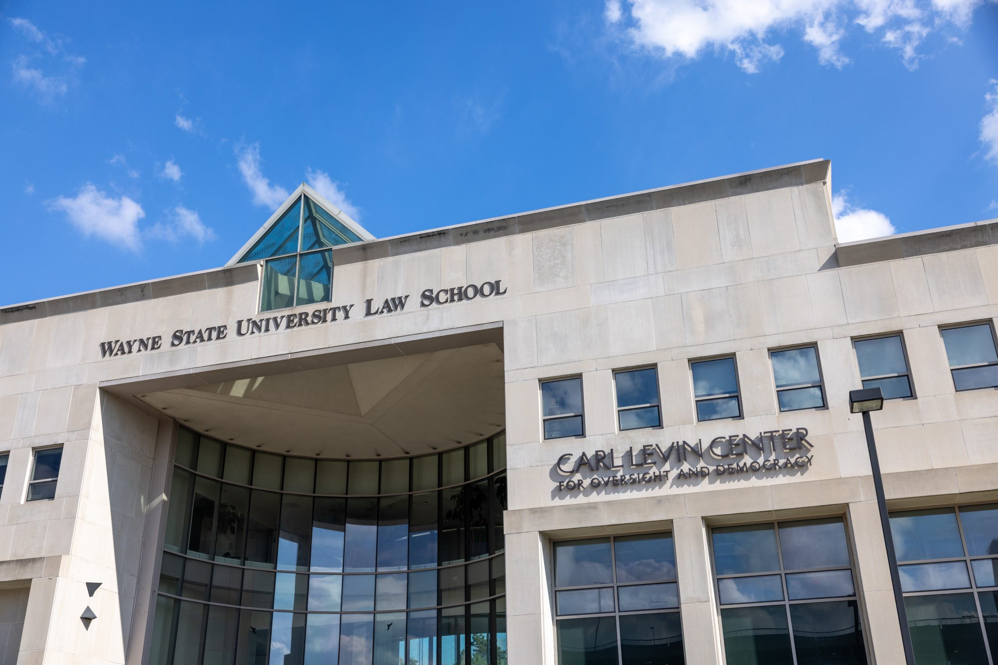
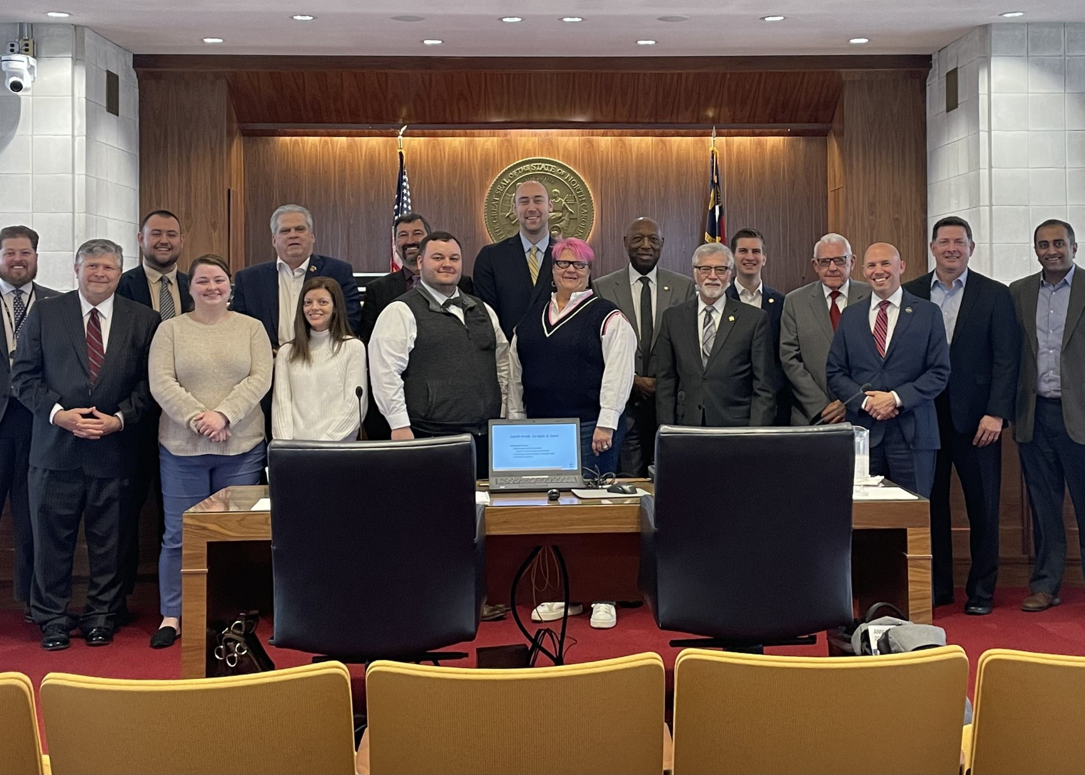
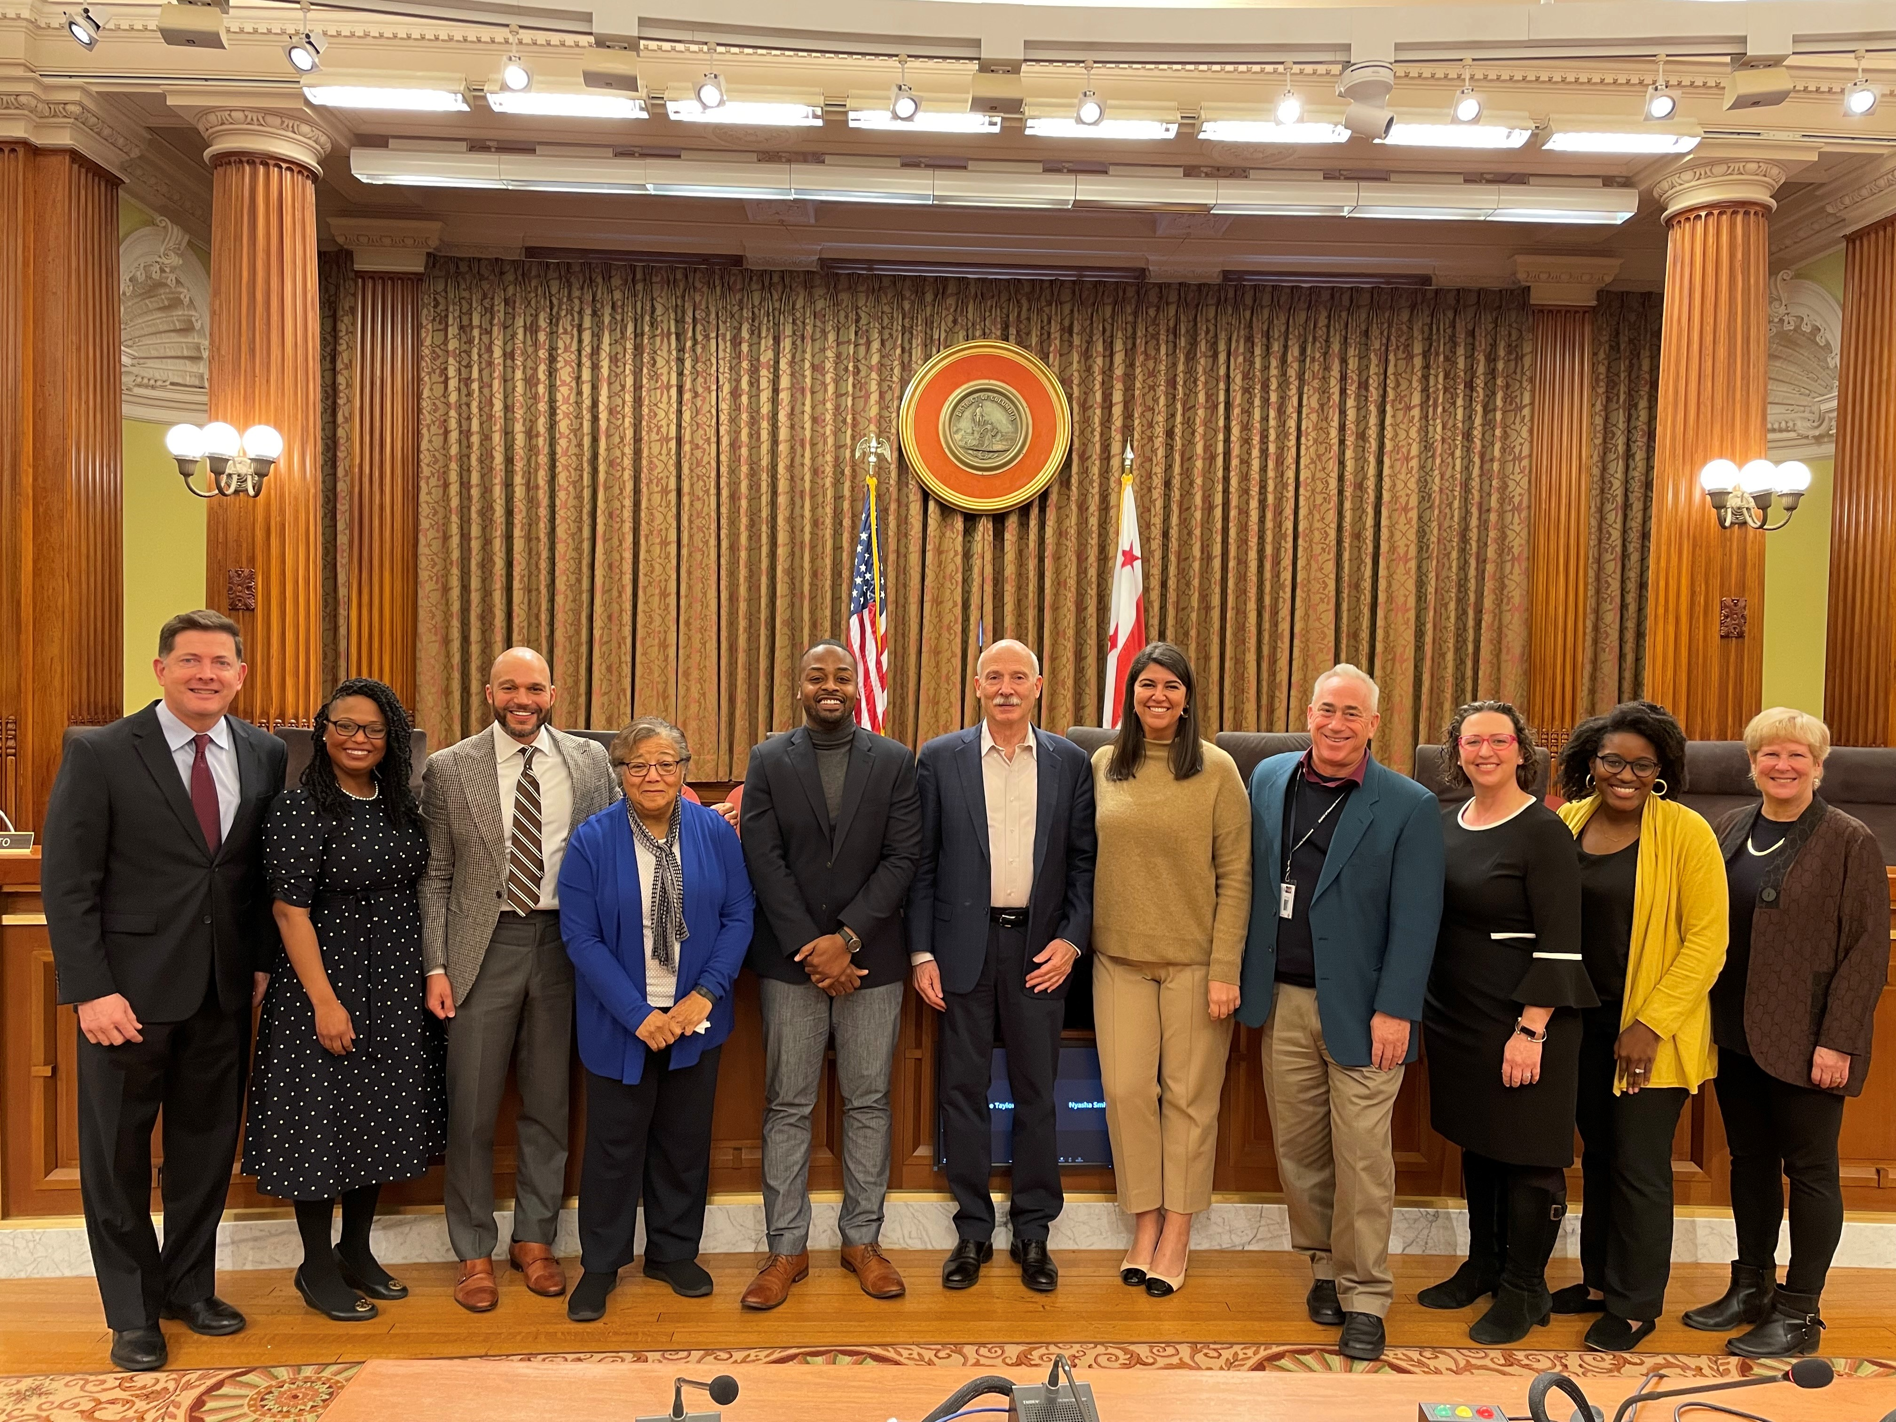
Levin Center for Oversight and Democracy​
U.S. Sen. Carl Levin
Pennsylvania Oversight Committee
Wayne State Law School
Workshops for Congress, state, international legislatures​
Videos, testimony, webinars, social media
Research & Reports (50-state analysis, contract oversight, more)​
Conferences, panels & events
State Oversight Academy
More: Benjamin.Eikey@wayne.edu
DC Council Oversight Workshop
North Carolina General Assembly
Oversight Workshop
levincenter@wayne.edu

Slide 3
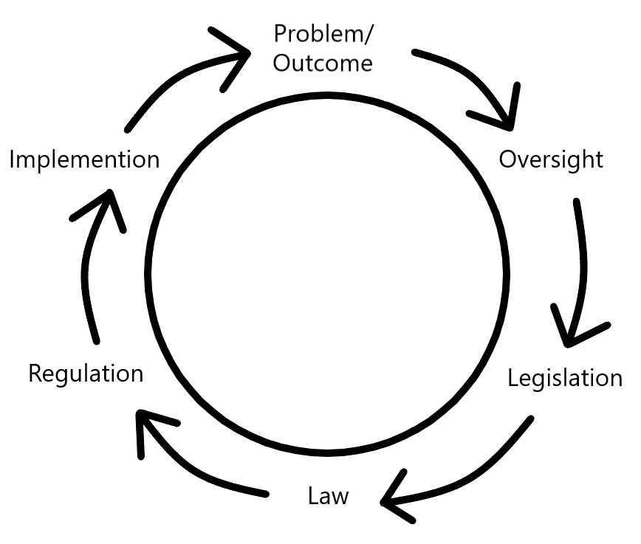
Cycle of Accountability
Eyes and Voice of
the People
levincenter@wayne.edu

Slide 4
Cycle of Accountability
Eyes and Voice of
the People
levincenter@wayne.edu

Slide 5
Connecticut
levincenter@wayne.edu

Slide 6
Connecticut Before 2014
1995: One of three states automatically tried 16 and 17 as adults.
2001: Governor rejected therapeutic youth corrections facility, instead supported one modeled after max security adult prison.
2005: 4,000 juveniles in detention center for status offenses or delinquency.
2006: Testimony, panel to raise the age
2007: Prohibited out-of-school suspension with rare exceptions.
2010: 30 percent decline in out-of-school suspensions.

Slide 7
Connecticut in 2014: Juvenile Justice Policy and Oversight Committee
“to evaluate policies related to the Juvenile Justice system and the expansion of juvenile jurisdiction to include persons sixteen and seventeen years of age.”
First report and recommendations in 2015 and 16.
Reduce juvenile incarceration rates
Increase diversion from juvenile justice system
Reduce recidivism
Address mental and behavioral health issues
Increase data sharing
CSG Improving Youth Outcomes Program
Juvenile Justice Equity Dashboard
”to monitor and examine juvenile justice system involvement across the state for youth of different races, ethnicities, and genders.”

Slide 8
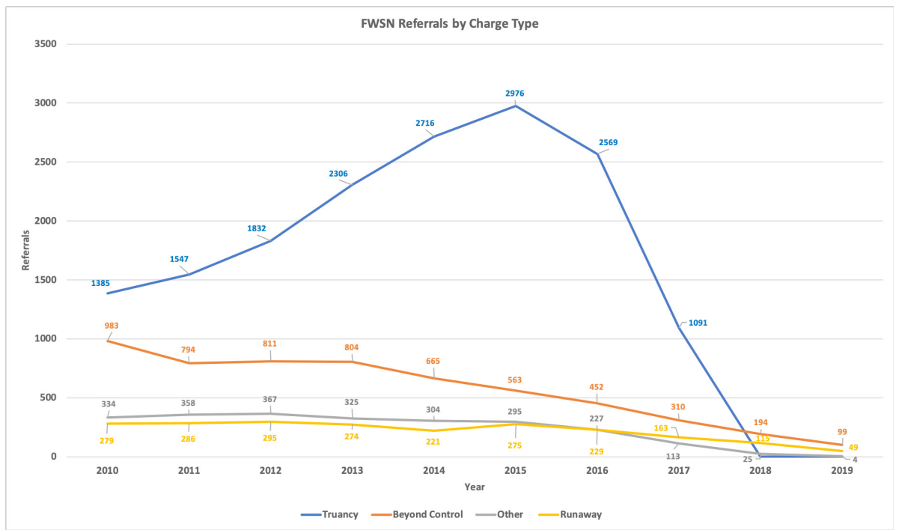
More on Connecticut
2015: Elimination of chronic absenteeism as a status offense
2017: Elimination of all FWSN offenses, redirected to community-based systems
Notes:
Has run away without just cause;
Is beyond control of his or her parents or guardians;
Has engaged in indecent or immoral conduct;
Is truant or defiant of school rules and regulations; and/or
Is 13 or older and has engaged in sexual intercourse with a person who is 13 or older and not more than 2 years younger

Slide 9
Connecticut Results
2015: Eliminated mandatory minimums for low-level drug offenses
2018: Strengthened visitation policies for all prisoners with children under age 18
2018: Raised the age of juvenile justice jurisdiction to 21
2019: Prohibited discrimination in employment, housing, public education, insurance, and government program and services based on criminal history.
Link: https://data.ct.gov/stories/s/efuz-5jhe

Slide 10
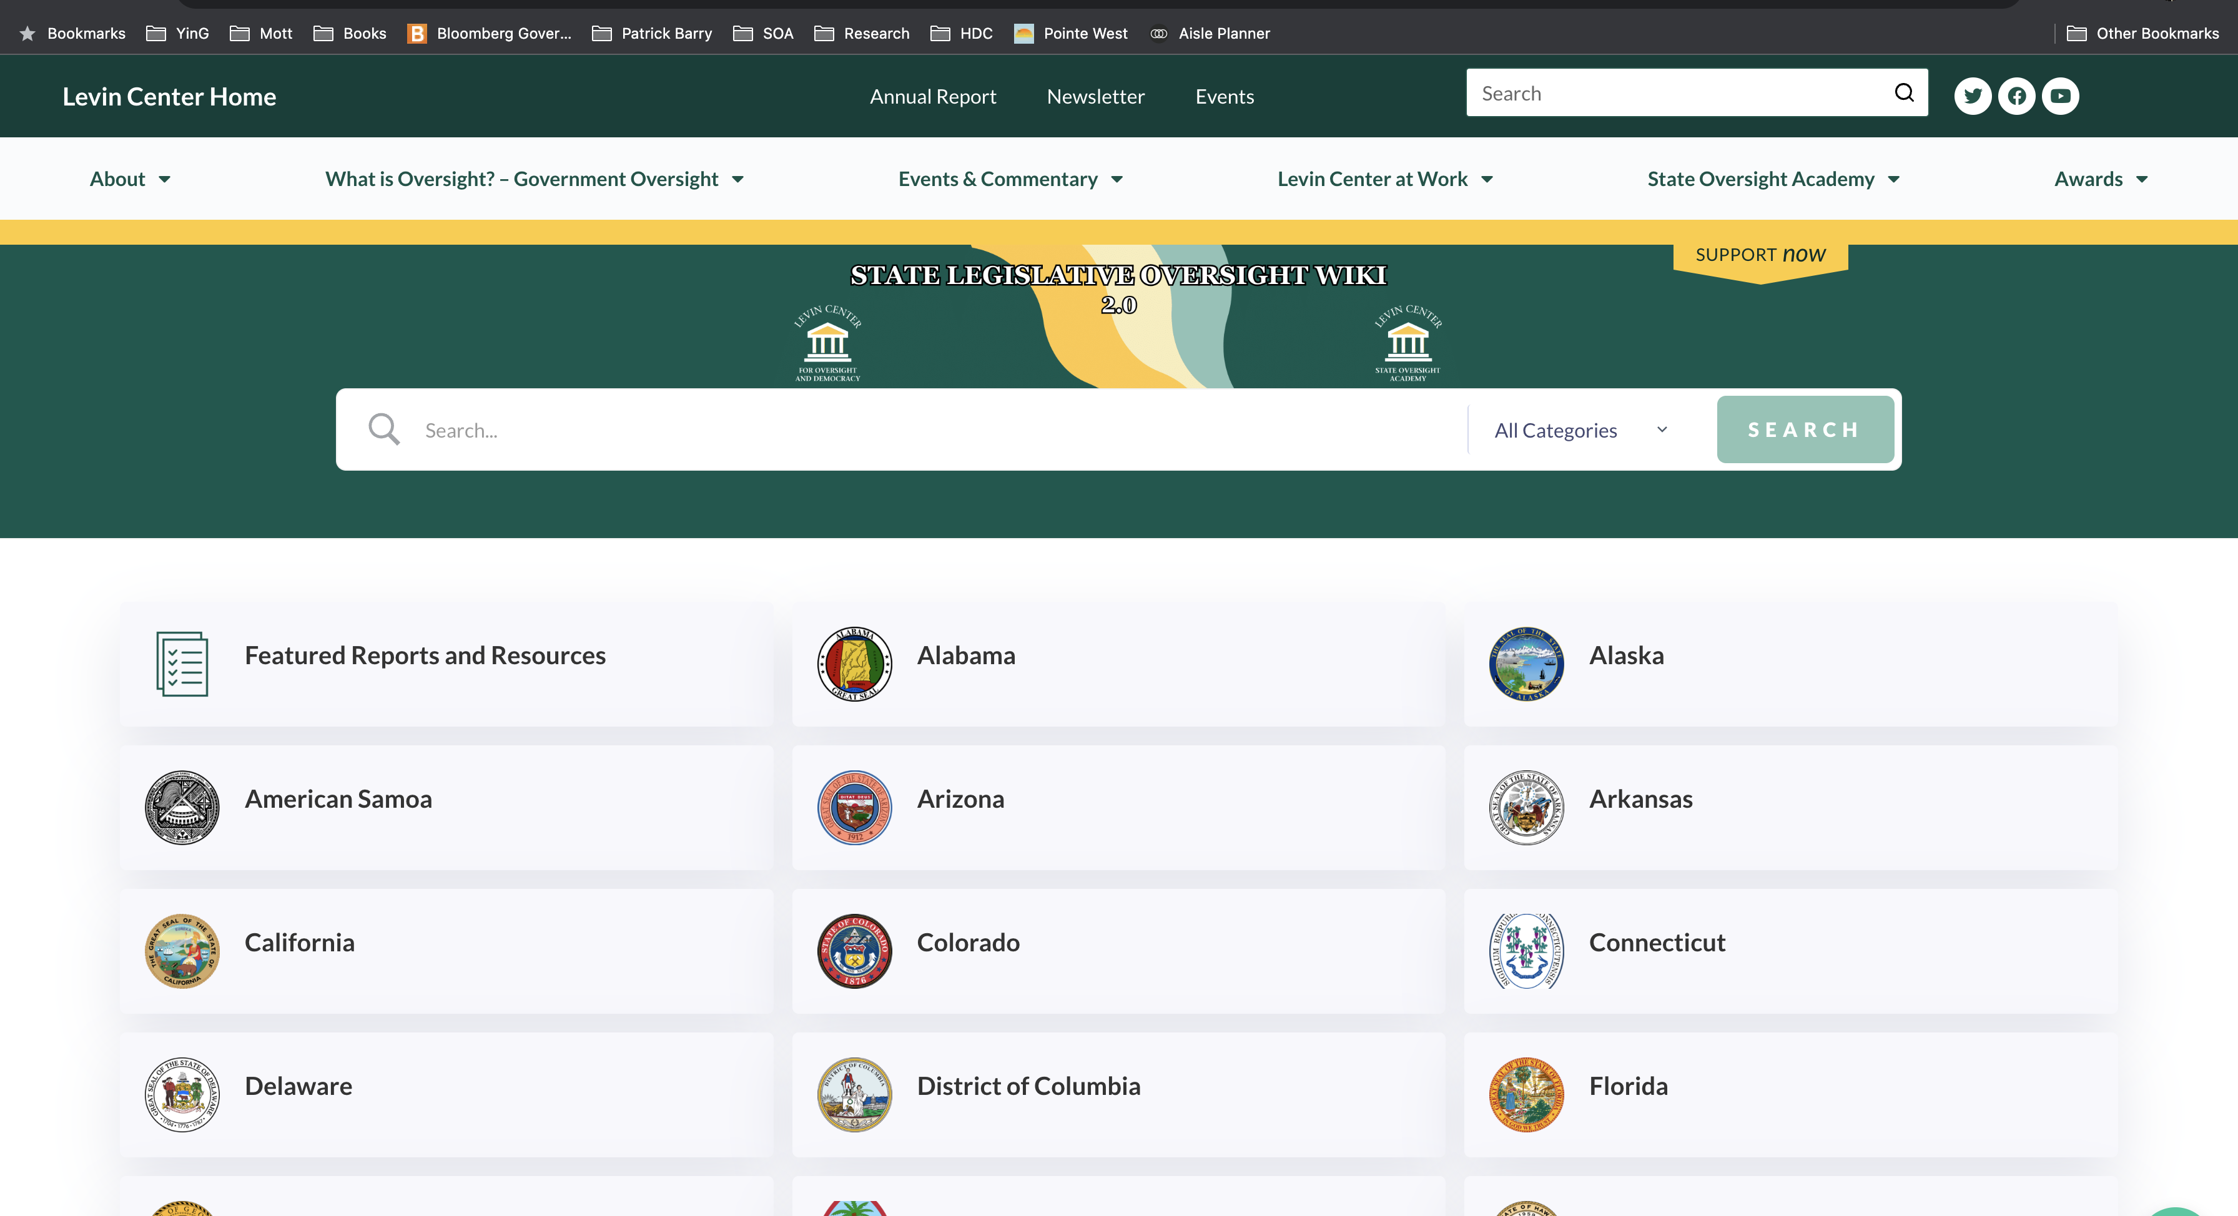
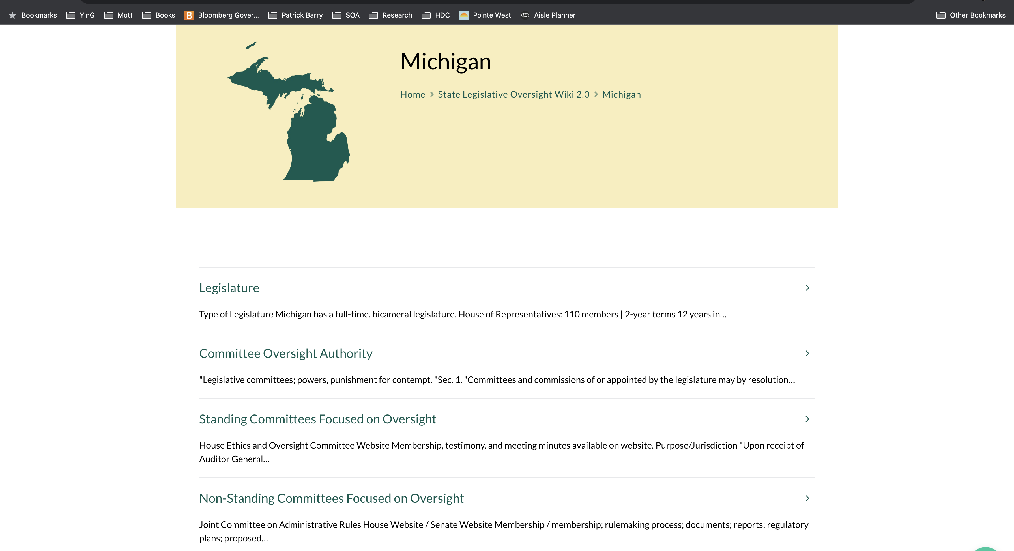
State Oversight Academy Wiki: https://www.levin-center.org/slow/

Slide 11
Oversight Plan
Topic | Subtopic | Factual Question | Avenue(s) | Routine/ Event Driven (Required Resources) | Timeline
Analytic Bureaucracies
Appropriations Process
Committees
Admin Rule Review
Advice and Consent
Monitoring Contracts
Reentry​
Diversion​
Education​
Healthcare​
Sentencing​
Recidivism​
Opioid Crisis​
More
levincenter@wayne.edu

Slide 12
Thank you!
For more information, contact:
Ben Eikey, Benjamin.Eikey@wayne.edu
State Oversight Resources: https://www.levin-center.org/state-lawmakers/state-oversight-resources/
State Oversight Workshops: https://www.levin-center.org/state-lawmakers/oversight-workshops/
levincenter@wayne.edu

